Slide 1
5.4 Regression Quality Metrics

Slide 2
In this Section we describe simple metrics for judging the quality of a trained regression model.
We also look at how to make predictions using a trained model.

Slide 3
Making predictions using a trained model

Slide 4



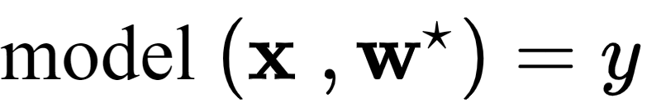
If we denote the optimal set of weights found by minimizing a regression cost function by then note we can write our fully tuned linear model as
Given an input (whether one from our training dataset or a new input) we predict its output by passing it along with our trained weights into our model as

Slide 5
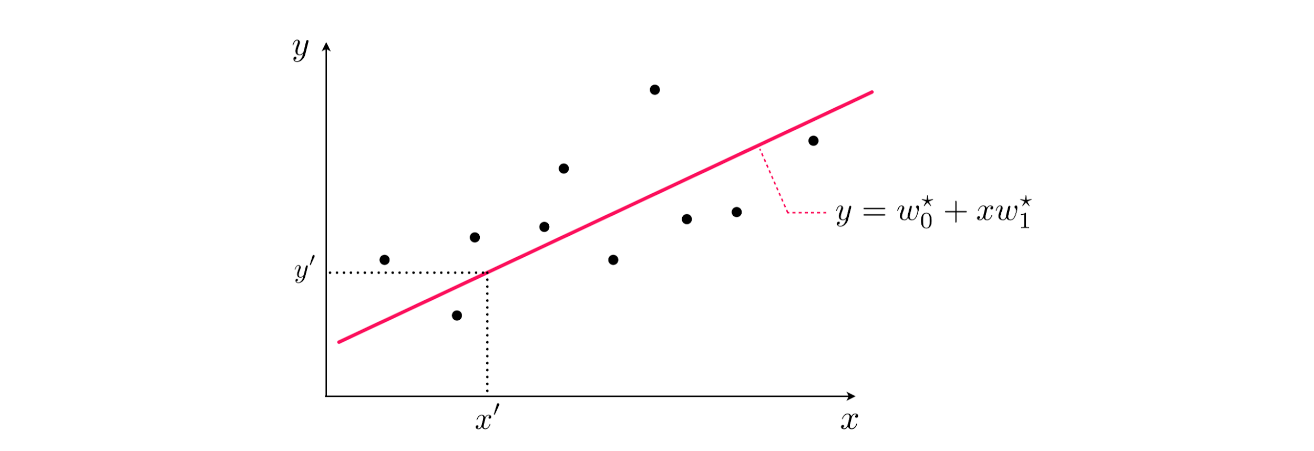

Slide 6
Judging the quality of a trained model

Slide 7
Once we have successfully minimized the a cost function for linear regression it is an easy matter to determine the quality of our regression model.
We must simply evaluate a cost function using our optimal weights.
We can then evaluate the quality of this trained model using a Least Squares cost.
This is especially natural to use when we employ this cost in training.

Slide 8
To do this we plug in our trained model and dataset into the Least Squares cost - giving the Mean Squared Error (or MSE for short) of our trained model
The name for this quality measurement describes precisely what the Least Squares cost computes - the average (or mean) squared error.

Slide 9
In the same way we can employ the Least Absolute Deviations cost to determine the quality of our trained model.
Plugging in our trained model and dataset into this cost computes the Mean Absolute Deviations (or MAD for short).
This is precisely what this cost function computes

Slide 10
These two measurements differ in precisely the ways we have seen their respective cost functions differ - e.g., the MSE measure is far more sensitive to outliers.
Which measure one employs in practice can therefore depend on personal and/or occupational preference, or the nature of a problem at hand.

Slide 11
Of course in general the lower one can make a quality measures, by proper tuning of model weights, the better the quality of the corresponding trained model (and vice versa).
However the threshold for what one considers 'good' or 'great' performance can depend on personal preference, an occupational or institutionally set benchmark, or some other problem-dependent concern.

